Slide 1
COMPUTER ARCHITECTURE & ORGANIZATION
Notes:
Manav Rachna College of Engineering

Slide 2
RISC vs. CISC

Slide 3
ISA
ISA stands for Instruction Set Architecture. The term Instruction Set Architecture is used in many different ways. It is the actual set of instructions that programmers can see, the glue that ties the hardware and software together.
ISA determines the way the machine language programs are constructed.
There are many different ISA's; most fall into two categories, RISC and CISC.

Slide 4
Microprogramming Concepts
Control Unit are implemented in one of the two ways:
Hardwired Control-RISC- The CU is made up of sequential & Combinational circuits to generate the control signals.
Micro programmed Control-CISC- A control memory on the processor contains micro programs that activate the necessary control signals.

Slide 5
CISC
Complex Instruction Set Computer are chips that are easy to program and which make efficient use of memory and are designed using Microprogramming approach.
Since the earliest machines were programmed in assembly language and memory was slow and expensive, the CISC philosophy made sense, and was commonly implemented in such large computers as the PDP-11.
The translation from HLL to MLL programs is done by a compiler program.
CISC was developed to make compiler development simpler. For example, instead of having to make a compiler write long machine instructions to calculate a square-root, a CISC processor would have a built-in ability to do this.

Slide 6
CISC
  Large number of complex instructions- typically from 100 to 250 instructions.
  Some instructions that perform specialized tasks and are used infrequently.
  A large variety of addressing modes- typically from 5 to 20 different modes.
  Variable –length instruction formats where the length often varies according to the addressing mode.
  Instruction that manipulate operands in memory.

Slide 7
Characteristics of CISC
Complex instruction-decoding logic, driven by the need for a single instruction to support multiple addressing modes.
A small number of general purpose registers & Several special purpose registers.
CISC machines use Microprogramming which is as easy as assembly language to implement, and much less expensive than hardwiring a control unit.

Slide 8
Disadvantages
That is, the incorporation of older instruction sets into new generations of processors tended to force growing complexity.
Different instructions will take different amounts of clock time to execute, slowing down the overall performance of the machine.
Many specialized CISC instructions were not used frequently enough to justify their existence.
Because each CISC command must be translated by the processor into tens or even hundreds of lines of microcode, it tends to run slower than an equivalent series of simpler commands that do not require so much translation.

Slide 9
CISC Examples
Examples of CISC processors are the
  System/360(excluding the 'scientific' Model 44),
  VAX,
  PDP-11,
  Motorola 68000 family
  Intel x86 architecture based processors.

Slide 10
RISC
Reduced Instruction Set Computer is a type of microprocessor architecture that utilizes a small, highly-optimized set of simplified instructions.
Relatively few instructions of fixed- length, easily decoded instruction format.
Relatively few addressing modes.
Memory access limited to Load & Store instructions.
Hardwired rather than micro programmed control.
All operations done within the registers of the CPU.
A relatively large number of registers in the processor unit to prevent in large amounts of interactions with memory.

Slide 11
RISC
Efficient instruction Pipeline.
One cycle execution time: RISC processors have a CPI (clock per instruction) of one cycle. This is due to the optimization of each instruction on the CPU and a technique called PIPELINING used to speed up RISC machines.
Pipelining: a technique that allows for simultaneous execution of parts, or stages, of instructions to more efficiently process instructions, this is done by overlapping the fetch, decode, and execute phase of two or three instructions.

Slide 12
RISC Examples
Apple iPods (custom ARM7TDMI SoC)
Apple iPhone (Samsung ARM1176JZF)
Palm and PocketPC PDAs and smartphones (Intel XScale family, Samsung SC32442 - ARM9)
Nintendo Game Boy Advance (ARM7)
Nintendo DS (ARM7, ARM9)
Sony Network Walkman (Sony in-house ARM based chip)
Some Nokia and Sony Ericsson mobile phones

Slide 13
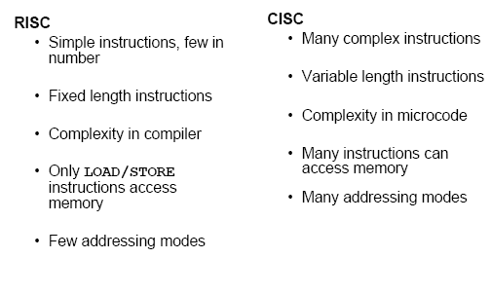
Comparison

Slide 14
Instruction Set Formats

Slide 15
Instruction Set Formats
1.) Fixed- length Instruction
Used in most RISC.
Instructions are 4 bytes long. For e.g. 32 or 64 bits
Allow for easy fetch & decode.
Simply pipelining and parallelism.
Fields: Operation, address field 1, address field 2, address field 3.
MIPS, SPARC, Power PC.

Slide 16
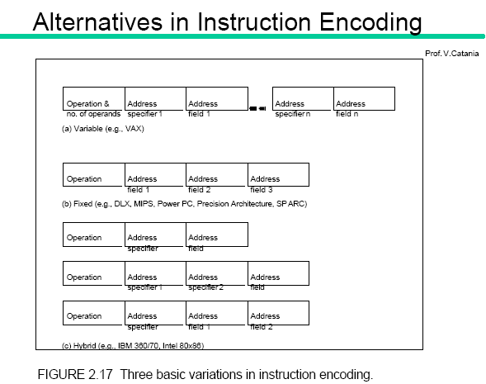
Fixed length instructions

Slide 17
Instruction Set Formats
2.) Variable Length Instructions
More Compact, harder to pipeline
Fields: Operation & # of operands, address specifier1, …, specifier n.
VAX, Intel 8086

Slide 18
Instruction Set Formats
3.) Hybrid length instructions
A mix of variable & fixed length instructions.
  Operation, address specifier, address field.
  Operation, address specifier 1, address specifier 2, address field.
  Operation, address field, address specifier 1, address specifier 2.

Slide 19
Hybrid

Slide 20
Summary
  If code size is most important, use variable format.
  If performance is most important, use fixed format.
  As for embedded applications, several RISC processors offer hybrid encoding method with both 16-bit and 32-bit instructions → reduce code size (e.g. ARM Thumb, MIPS16)

Slide 21
Operations in the Instruction Set

Slide 22
3 Categories of Computer Instructions
Data transfer instructions: cause transfer of data from one location to another without changing the binary information content.
Data manipulation instructions: performs arithmetic, logic and shift operations.
Program control instructions: provide decision making capabilities and change the path taken by the program when executed in the computer.

Slide 23
Data Transfer Instructions
Name Mnemonic
Load LD
Store ST
Move MOV
Exchange XCH
Input IN
Output OUT
Push PUSH
Pop POP

Slide 24
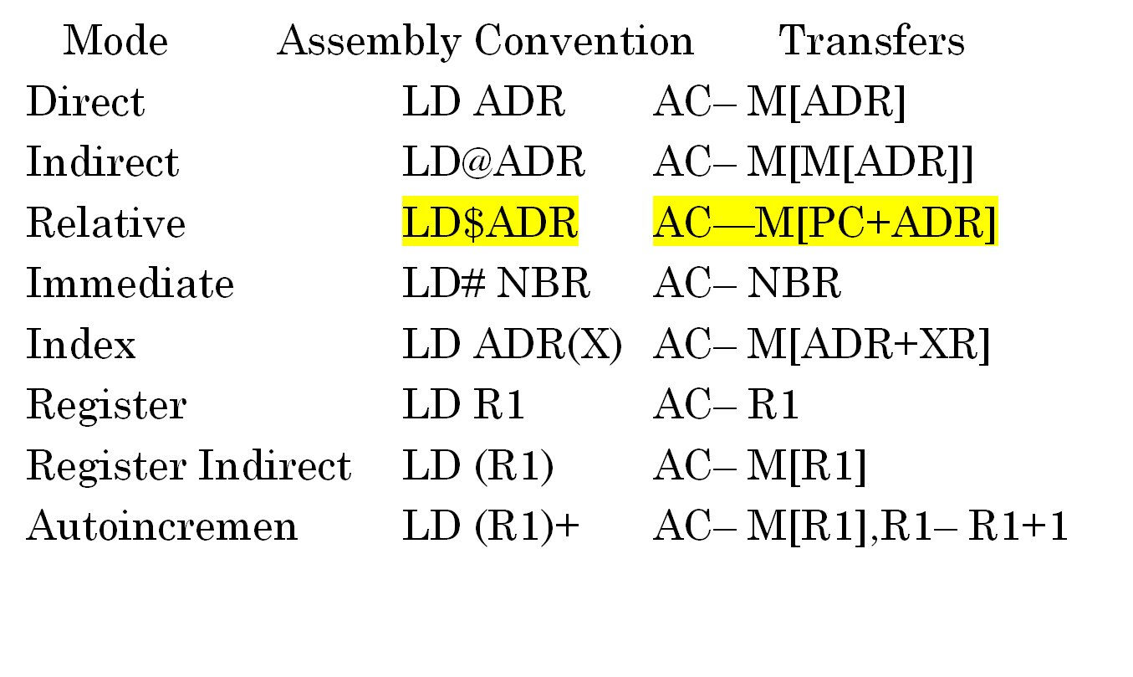
Addressing modes for Load instruction

Slide 25
Data Manipulation Instructions
1.) Arithmetic Instruction
Name Mnemonics
Increment INC
Decrement DEC
Add ADD
Subtract SUB
Multiply MUL
Divide DIV
Add with carry ADDC
Subtract with borrow SUBB
Negate NEG

Slide 26
Data Manipulation Instructions
2.) Logical and Bit Manipulation Instructions
Name Mnemonics
Clear CLR
Complement COM
AND AND
OR OR
Exclusive-OR XOR
Clear carry CLRC
Enable interrupt EI
Disable interrupt DI

Slide 27
Data Manipulation Instructions
3.) Shift Instructions
Name Mnemonics
Logical shift right SHR
Logical shift left SHL
Arithmetic shift right SHRA
Arithmetic shift left SHLA
Rotate right ROR
Rotate left ROL

Slide 28
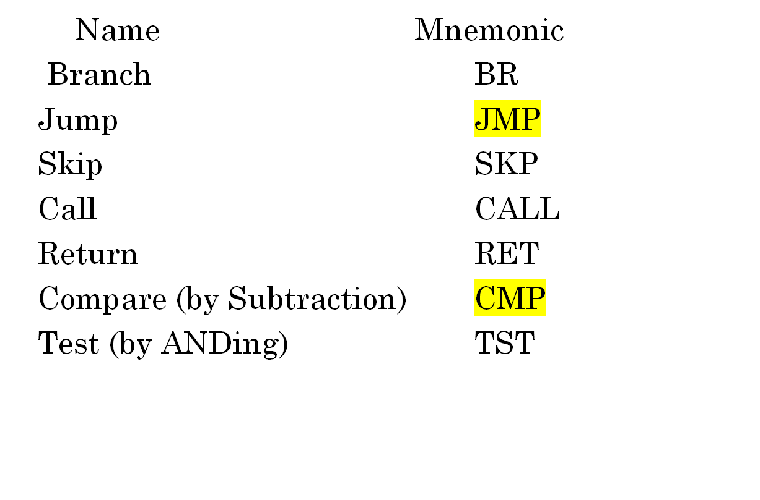
Program Control

Slide 29
DESIGN OF ACCUMULATOR LOGIC
Circuits associated with AC
16
16
Adder and
16
16
From DR
logic
AC
8
circuit
To bus
From INPR
LD
INR
CLR
Clock
Control
gates
All the statements that change the content of AC
D₀T₅: AC ← AC ∧ DR AND with DR
D₁T₅: AC ← AC + DR Add with DR
D₂T₅: AC ← DR Transfer from DR
pB₁₁: AC(0-7) ← INPR Transfer from INPR
rB₉: AC ← AC′ Complement
rB₇ : AC ← shr AC, AC(15) ← E Shift right
rB₆ : AC ← shl AC, AC(0) ← E Shift left
rB₁₁ : AC ← 0 Clear
rB₅ : AC ← AC + 1 Increment

Slide 30
CONTROL OF AC REGISTER
Gate structures for controlling
the LD, INR, and CLR of AC
From Adder
16
16
To bus
and Logic
AC
D
AND
Clock
0
LD
T
5
INR
D
ADD
1
CLR
D
DR
2
T
5
p
INPR
B
11
r
COM
B
9
SHR
B
7
SHL
B
6
INC
B
5
CLR
B
11

